Slide 1
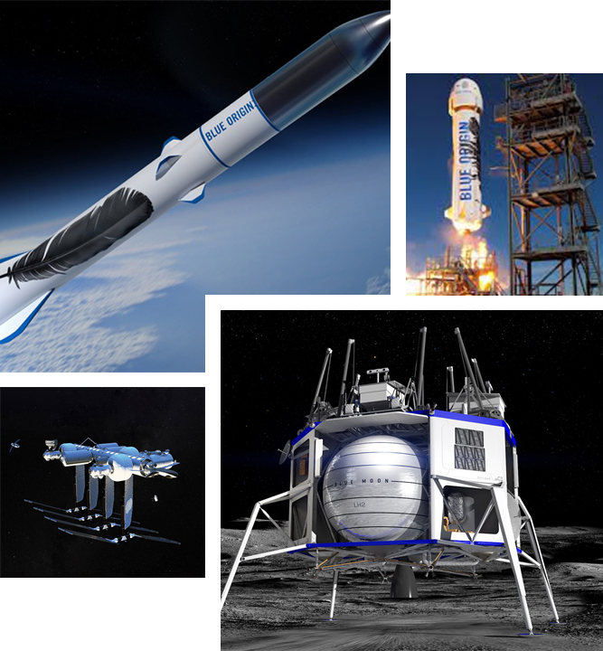
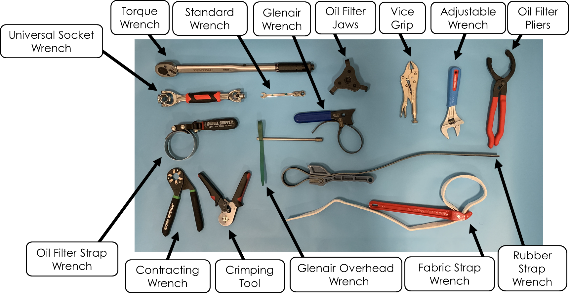
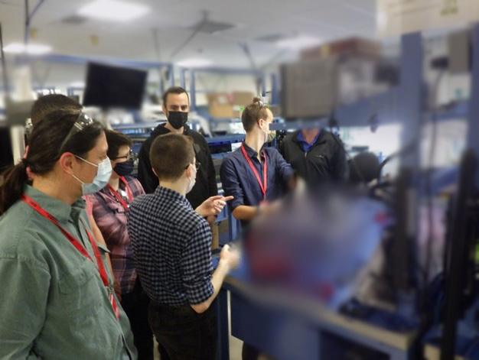
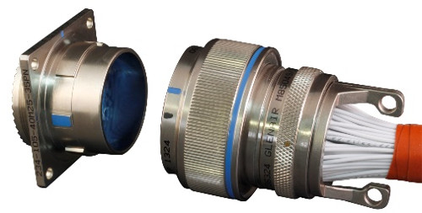
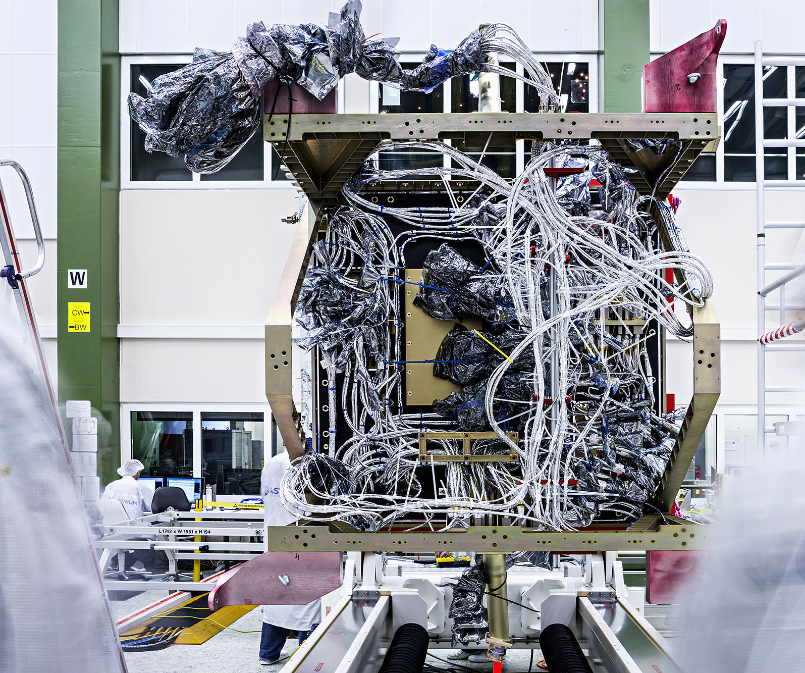
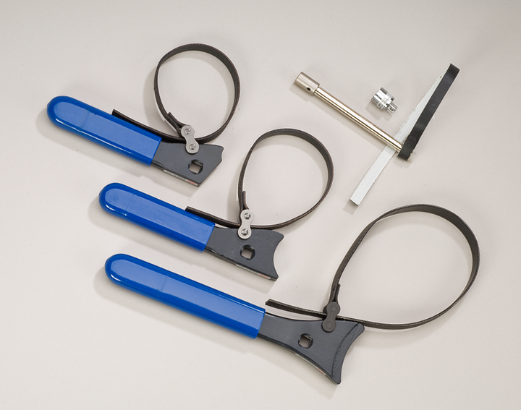
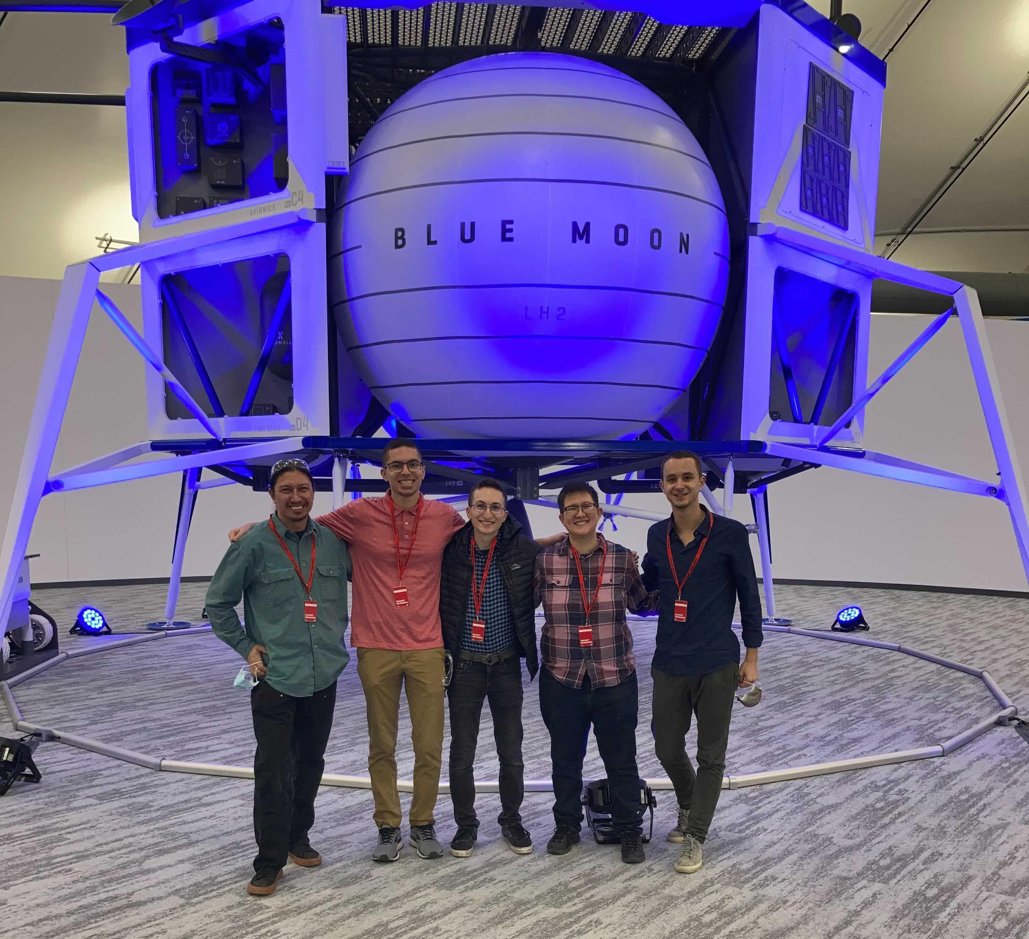
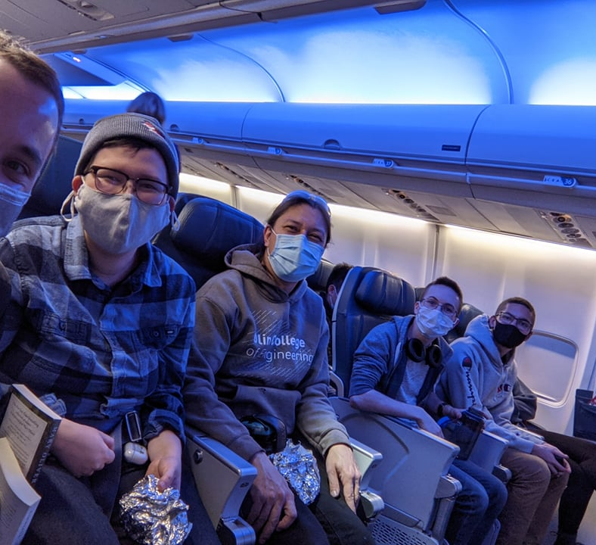
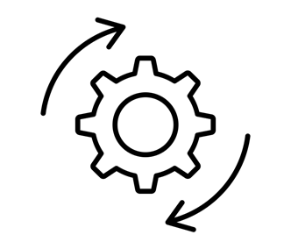
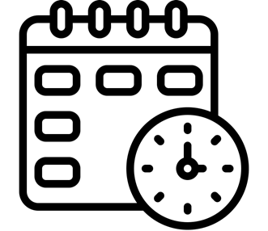
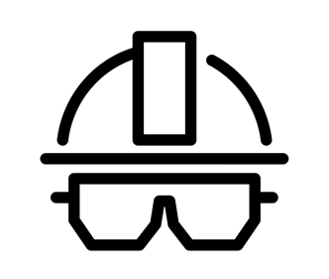
Blue Origin SCOPE TEAM
New Glenn Avionics Assembly Tooling
About Blue Origin
Our Process
Blue Origin is developing technologies that will enables humans to live and work in space. Blue is committed to building a road to space so our children can build the future. ​
Our team implemented an iterative design process to define the problem and work through multiple solutions. We utilized techniques such as sketching, CAD, prototyping and design for manufacturing (DFM) to bring our ideas from concepts to real working tools. Our iteration process resulted in us delivering both a primary and secondary tool to Blue.
The Problem
The Team
Students:
Theo Johnson, Argyris Kriezis,
Jonathan Montague, Mads Young
Faculty Advisor:
Jessica Townsend
Assembly with current tools takes a long time
Reusable systems need to have rapid turnaround
The assembly process need to be reliable
Subject Mater Expert:
Nate Cantrell
Blue Origin Liaison:
David Llapitan

